Slide 1

Telling a Story
with your Data
Work file

Slide 2
INITIATION
Scope statement (problem statement)
Risk Context
PLAN
Create implementation plan
Create transition plan
Create communication plan
Identify necessary approvals
DO
Implement plans
Notify affected parties
Conduct necessary training and qualification
CLOSE-OUT
Capture lessons-learned
Update documents and records
INITIATION
DESIGN
PLAN
APPROVAL
DO
CHECK
CLOSE OUT
DESIGN
Conduct root cause analysis
Conduct risk assessment
Design change
Identify implications of change
Identify affected parties
APPROVAL
Obtain necessary approvals to proceed with implementation of requested change
CHECK
Verify training and change objectives were met

Slide 3
INITIATION
  Scope statement (problem statement)
  Risk Context
DESIGN
  Conduct root cause analysis
  Conduct risk assessment
  Design change
  Identify implications of change
  Identify affected parties
PLAN
  Create an implementation plan
  Create a transition plan
  Create a communication plan
  Identify necessary approvals
APPROVAL
  Obtain necessary approvals to proceed with the implementation of the requested change
DO
  Implement plans
  Notify affected parties
  Conduct necessary training and qualification
CHECK
  Verify training and change objectives were met
CLOSE-OUT
  Capture lessons-learned
  Update documents and records

Slide 4
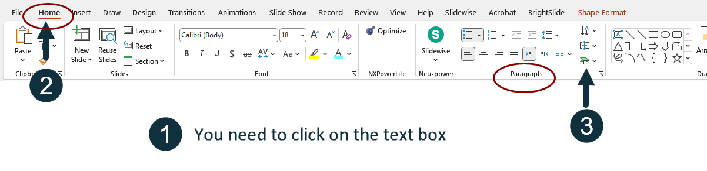

Slide 5
INITIATION
  Scope statement (problem statement)
  Risk Context
DESIGN
  Conduct root cause analysis
  Conduct risk assessment
  Design change
  Identify implications of change
  Identify affected parties
PLAN
  Create an implementation plan
  Create a transition plan
  Create a communication plan
  Identify necessary approvals
APPROVAL
  Obtain necessary approvals to proceed with the implementation of the requested change
DO
  Implement plans
  Notify affected parties
  Conduct necessary training and qualification
CHECK
  Verify training and change objectives were met
CLOSE-OUT
  Capture lessons-learned
  Update documents and records

Slide 6
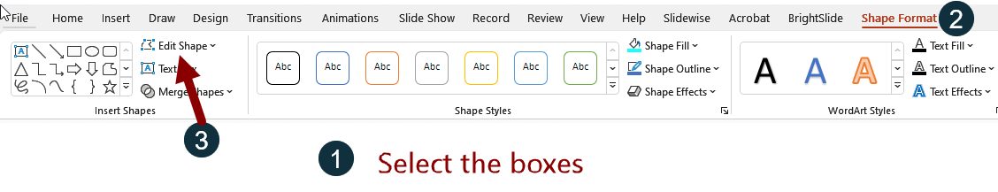
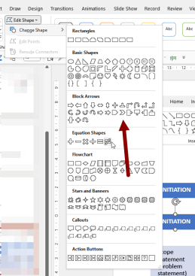
INITIATION
DESIGN
PLAN
APPROVAL
DO
CHECK
CLOSE-OUT
INITIATION
DESIGN
PLAN
APPROVAL
DO
CHECK
CLOSE-OUT
  Scope statement (problem statement)
  Risk Context
  Conduct root cause analysis
  Conduct risk assessment
  Design change
  Identify implications of change
  Identify affected parties
  Create an implementation plan
  Create a transition plan
  Create a communication plan
  Identify necessary approvals
  Obtain necessary approvals to proceed with the implementation of the requested change
  Implement plans
  Notify affected parties
  Conduct necessary training and qualification
  Verify training and change objectives were met
  Capture lessons-learned
  Update documents and records

Slide 7
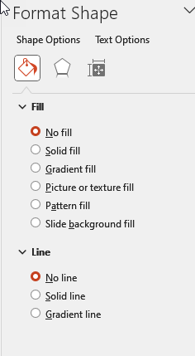
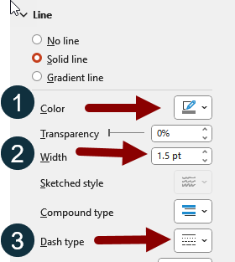
INITIATION
DESIGN
PLAN
APPROVAL
DO
CHECK
CLOSE-OUT
  Scope statement (problem statement)
  Risk Context
  Conduct root cause analysis
  Conduct risk assessment
  Design change
  Identify implications of change
  Identify affected parties
  Create an implementation plan
  Create a transition plan
  Create a communication plan
  Identify necessary approvals
  Obtain necessary approvals to proceed with the implementation of the requested change
  Implement plans
  Notify affected parties
  Conduct necessary training and qualification
  Verify training and change objectives were met
  Capture lessons-learned
  Update documents and records

Slide 8
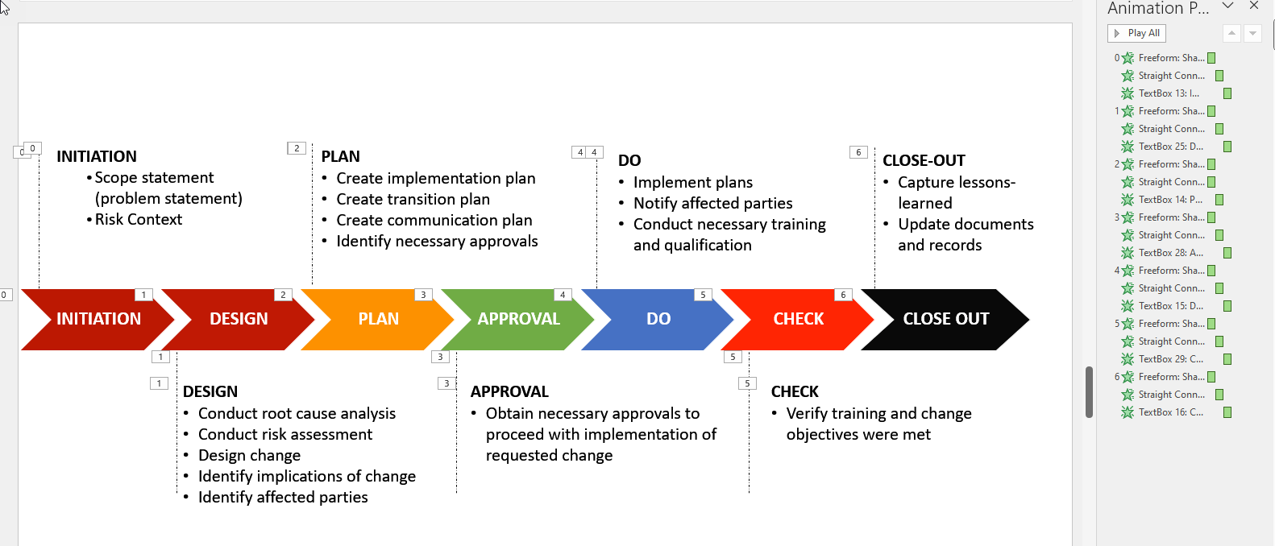

Slide 9


Slide 10
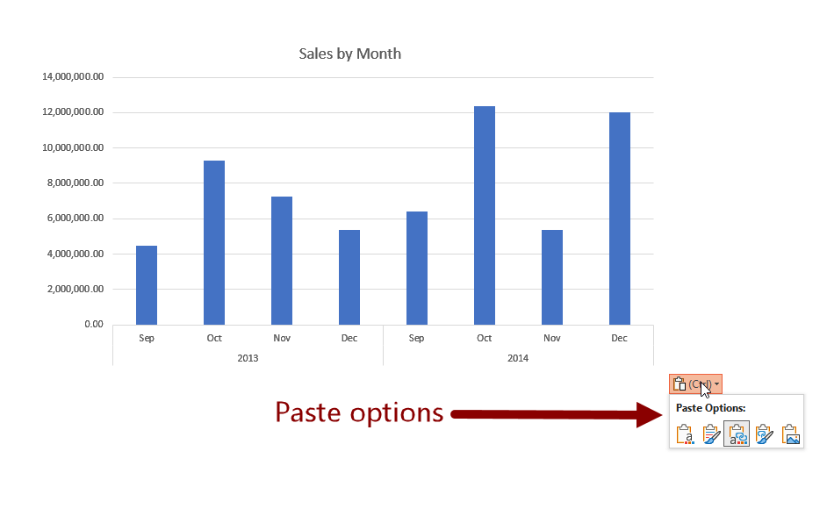

Slide 11
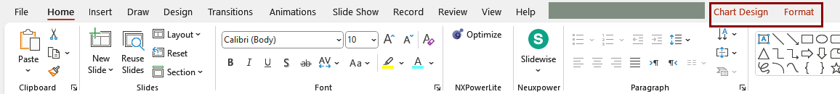
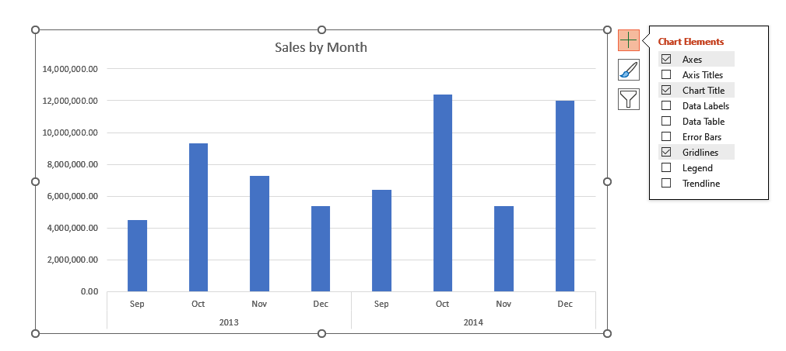

Slide 12
